Slide 1
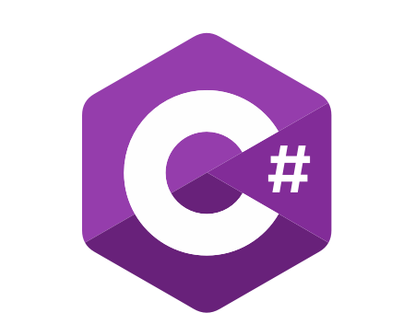
C# Advanced
Course Introduction
SoftUni Team
Technical Trainers
Software University
https://softuni.bg/

Slide 2
Table of Contents
Course Objectives
Training and Team
Course Organization
Course Infrastructure
Evaluation Criteria

Slide 3
Have a Question?
sli.do
#csharp-advanced

Slide 4

Course Objectives

Slide 5
C# Advanced Module Goals
Working with linear data structures
Getting familiar with streams and files
Creating custom data structures
Building class hierarchies
Working with Exceptions
Applying principles and good practices for building quality software
Testing application correctness

Slide 6
C# Advanced Course Goals
Working with linear data structures
Stacks, Queues and Multidimensional Arrays
Getting familiar with streams and files
Creating custom data structures
List, Stack and LinkedList
Simple algorithms
Recursion, Sorting and Searching

Slide 7
Practical Programming Exam
3 practical problems for 4 hours
The first two problems may include:
Stacks and Queues
Multidimensional Arrays
Dictionaries
Defining Classes
Automated judge system
http://judge.softuni.bg
Solutions are evaluated for correctness only
Code quality is still not measured

Slide 8
Theoretical Exam
You will have 30 minutes once you enter
Multiple-choice with 1 or more correct answers
English
Automated quiz system
Available during the practical exam and 30 minutes after it
You can submit your answers just one time
Advice: Start it when you finish the practical exam

Slide 9

The Team

Slide 10
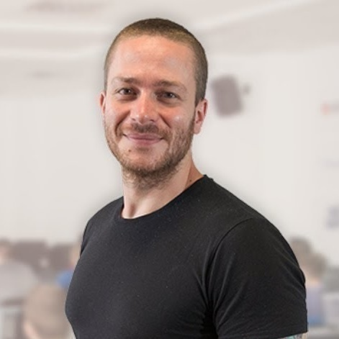
Ivaylo Kenov
Various job titles at the same time:
CTO @ SoftUni Dev Team
Technical Trainer @ SoftUni
Creator of open-source libraries for ASP.NET
MyTested.AspNetCore.Mvc
Mathematical competitions champion
Contacts:
https://github.com/ivaylokenov
https://linkedin.com/in/kenov

Slide 11
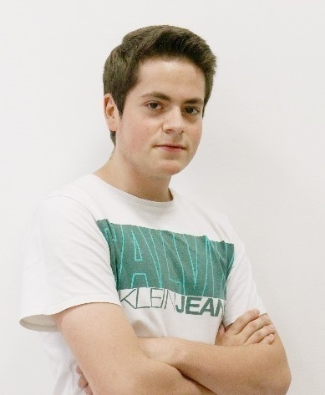
Kristiyan Ivanov
Top Student @ SoftUni
Technical Trainer @ SoftUni
Student @ NBU
Interests include mechanics and electronics
Love playing with Arduino
Mountain lover

Slide 12

Course Organization

Slide 13
C# Advanced Module – Timeline
14-January-2020
22-February-2020
25-February-2020
12-April-2020
C# Advanced
6 weeks * 4 times / week
12 credits
Start: 14-January-2020
Theoretical Exam: 22-February-2020
Practical Exam: 22-February-2020
Theoretical Exam Retake: 14-April-2020
Practical Exam Retake: 14-April-2020
C# OOP
7 weeks * 4 times / week
15 credits
Start: 25-February-2020
Theoretical Exam: 12-April-2020
Practical Exam: 12-April-2020
Theoretical Exam Retake: 16-April-2020
Practical Exam Retake: 16-April-2020

Slide 14

Homework Assignments & Exercises
Your homework is mainly work in class
Lesson days → slides + live demos + exercises
Exercise days → only exercises
How to submit your homework?
Submitted in the judge system
Do your homework when it's due
Assignments pile up quickly

Slide 15



Scoring System for the Course
Theoretical Exam 5%
PracticalExam 90%
Presence in class 5%
Evaluation
Homework 5 %

Slide 16



Course Web Site, Forum and FB Group
Official web site:
Official discussion forum:
Official Facebook group:
Community Facebook group:
https://softuni.bg/courses/csharp-advanced/
https://softuni.bg/forum/categories/30/
https://www.facebook.com/groups/CSharpAdvancedJanuary2020/
https://www.facebook.com/SoftUniCSharpCommunity/

Slide 17


The Free C# Fundamentals Textbook
The official textbook for the course
"Fundamentals of Computer Programming with C#", by Svetlin Nakov & Co., 2013, ISBN 9789544007737
English and Bulgarian versions (as PDF, ePub, …)
Freely downloadable from: www.introprogramming.info
The C# Programming courses @SoftUni.bg partially follows the book

Slide 18
Questions?
Notes:
18

Slide 19












SoftUni Diamond Partners

Slide 20




SoftUni Organizational Partners

Slide 21
Trainings @ Software University (SoftUni)
Software University – High-Quality Education, Profession and Job for Software Developers
softuni.bg, softuni.org
Software University Foundation
softuni.foundation
Software University @ Facebook
facebook.com/SoftwareUniversity
Software University Forums
forum.softuni.bg
Notes:
21

Slide 22

License
This course (slides, examples, demos, exercises, homework, documents, videos and other assets) is copyrighted content
Unauthorized copy, reproduction or use is illegal
© SoftUni – https://softuni.org
© Software University – https://softuni.bg
Notes:
22

